Slide 1
BS2009 - GENOMES
DNA replication and repair

Slide 2
REPLICATION – GENERAL PRINCIPLES
START
Must be ready
Must know where to start
FINISH
Must all finish
Must ensure that each piece of DNA is replicated only once
Therefore must know where to finish

Slide 3
REPLICATION – GENERAL PRINCIPLES
ACCURACY/FIDELITY
Proof reading/repair
Must distinguish between original and copy

Slide 4
THE EUKARYOTIC CELL CYCLE
S phase
DNA synthesis
G1
Growth phase 1
Main checkpoints
G2
Growth phase 2
Go
Quiescent
M
Mitosis

Slide 5
REPLICATION – GENERAL PRINCIPLES
START
Must be ready: G1
Must all start at the same time: G1 S
Must know where to start
ORIGIN OF REPLICATION
FINISH
Must all finish (complete S)
Must ensure that each piece of DNA is replicated only once
Therefore must know where to finish (REPLICON)

Slide 6
REPLICATION – GENERAL PRINCIPLES
ACCURACY/FIDELITY
Proof reading/repair (G2)
Must distinguish between original and copy (EPIGENETICS)

Slide 7
Summary
DNA Replication
Occurs during S phase of the cell cycle
Semi-conservative (Meselson & Stahl)
5’ → 3’direction leading strand lagging strand (discontinuous)
RNA primer

Slide 8
Summary
Single origin in bacteria
Multiple origins in eukaryotes
Bi-directional
ARS elements from yeast cloned origins

Slide 9
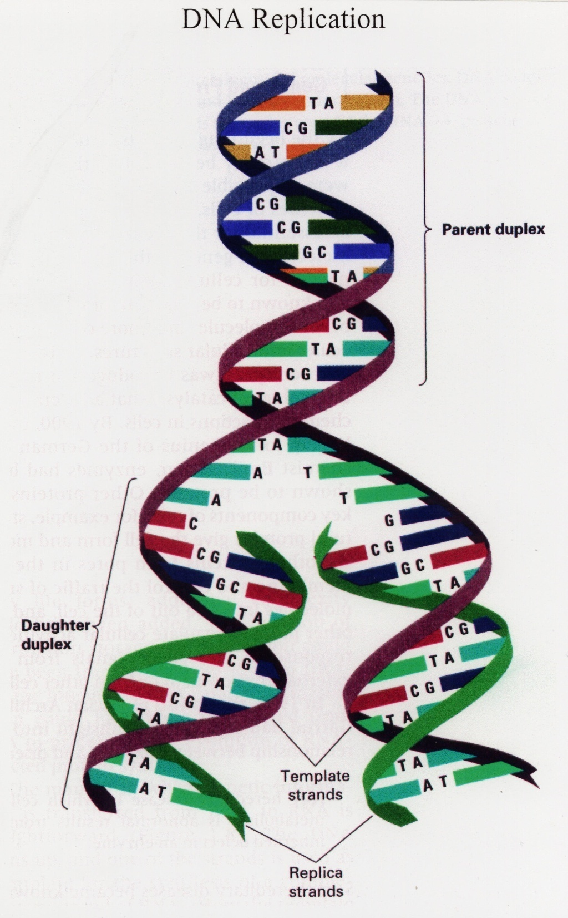
SEMI CONSERVATIVE

Slide 10
DNA polymerase
5’
OH 3’
3’
5’
5’
OH 3’
3’
5’
5’
OH 3’
3’
5’
DNA synthesis always occurs by adding
nucleotides to the 3’-OH of the growing strand.
Synthesis is always in the 5’- 3’ direction

Slide 11
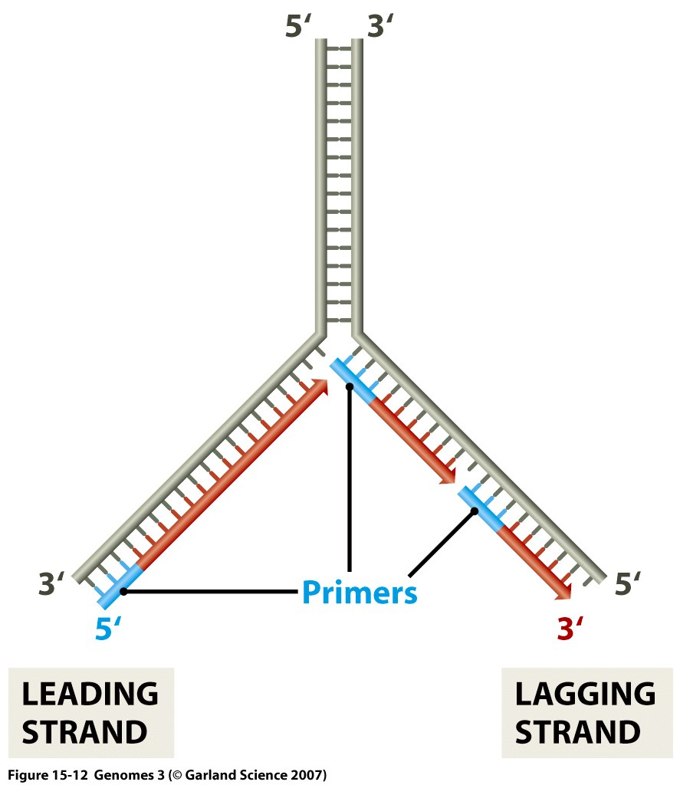

Slide 12
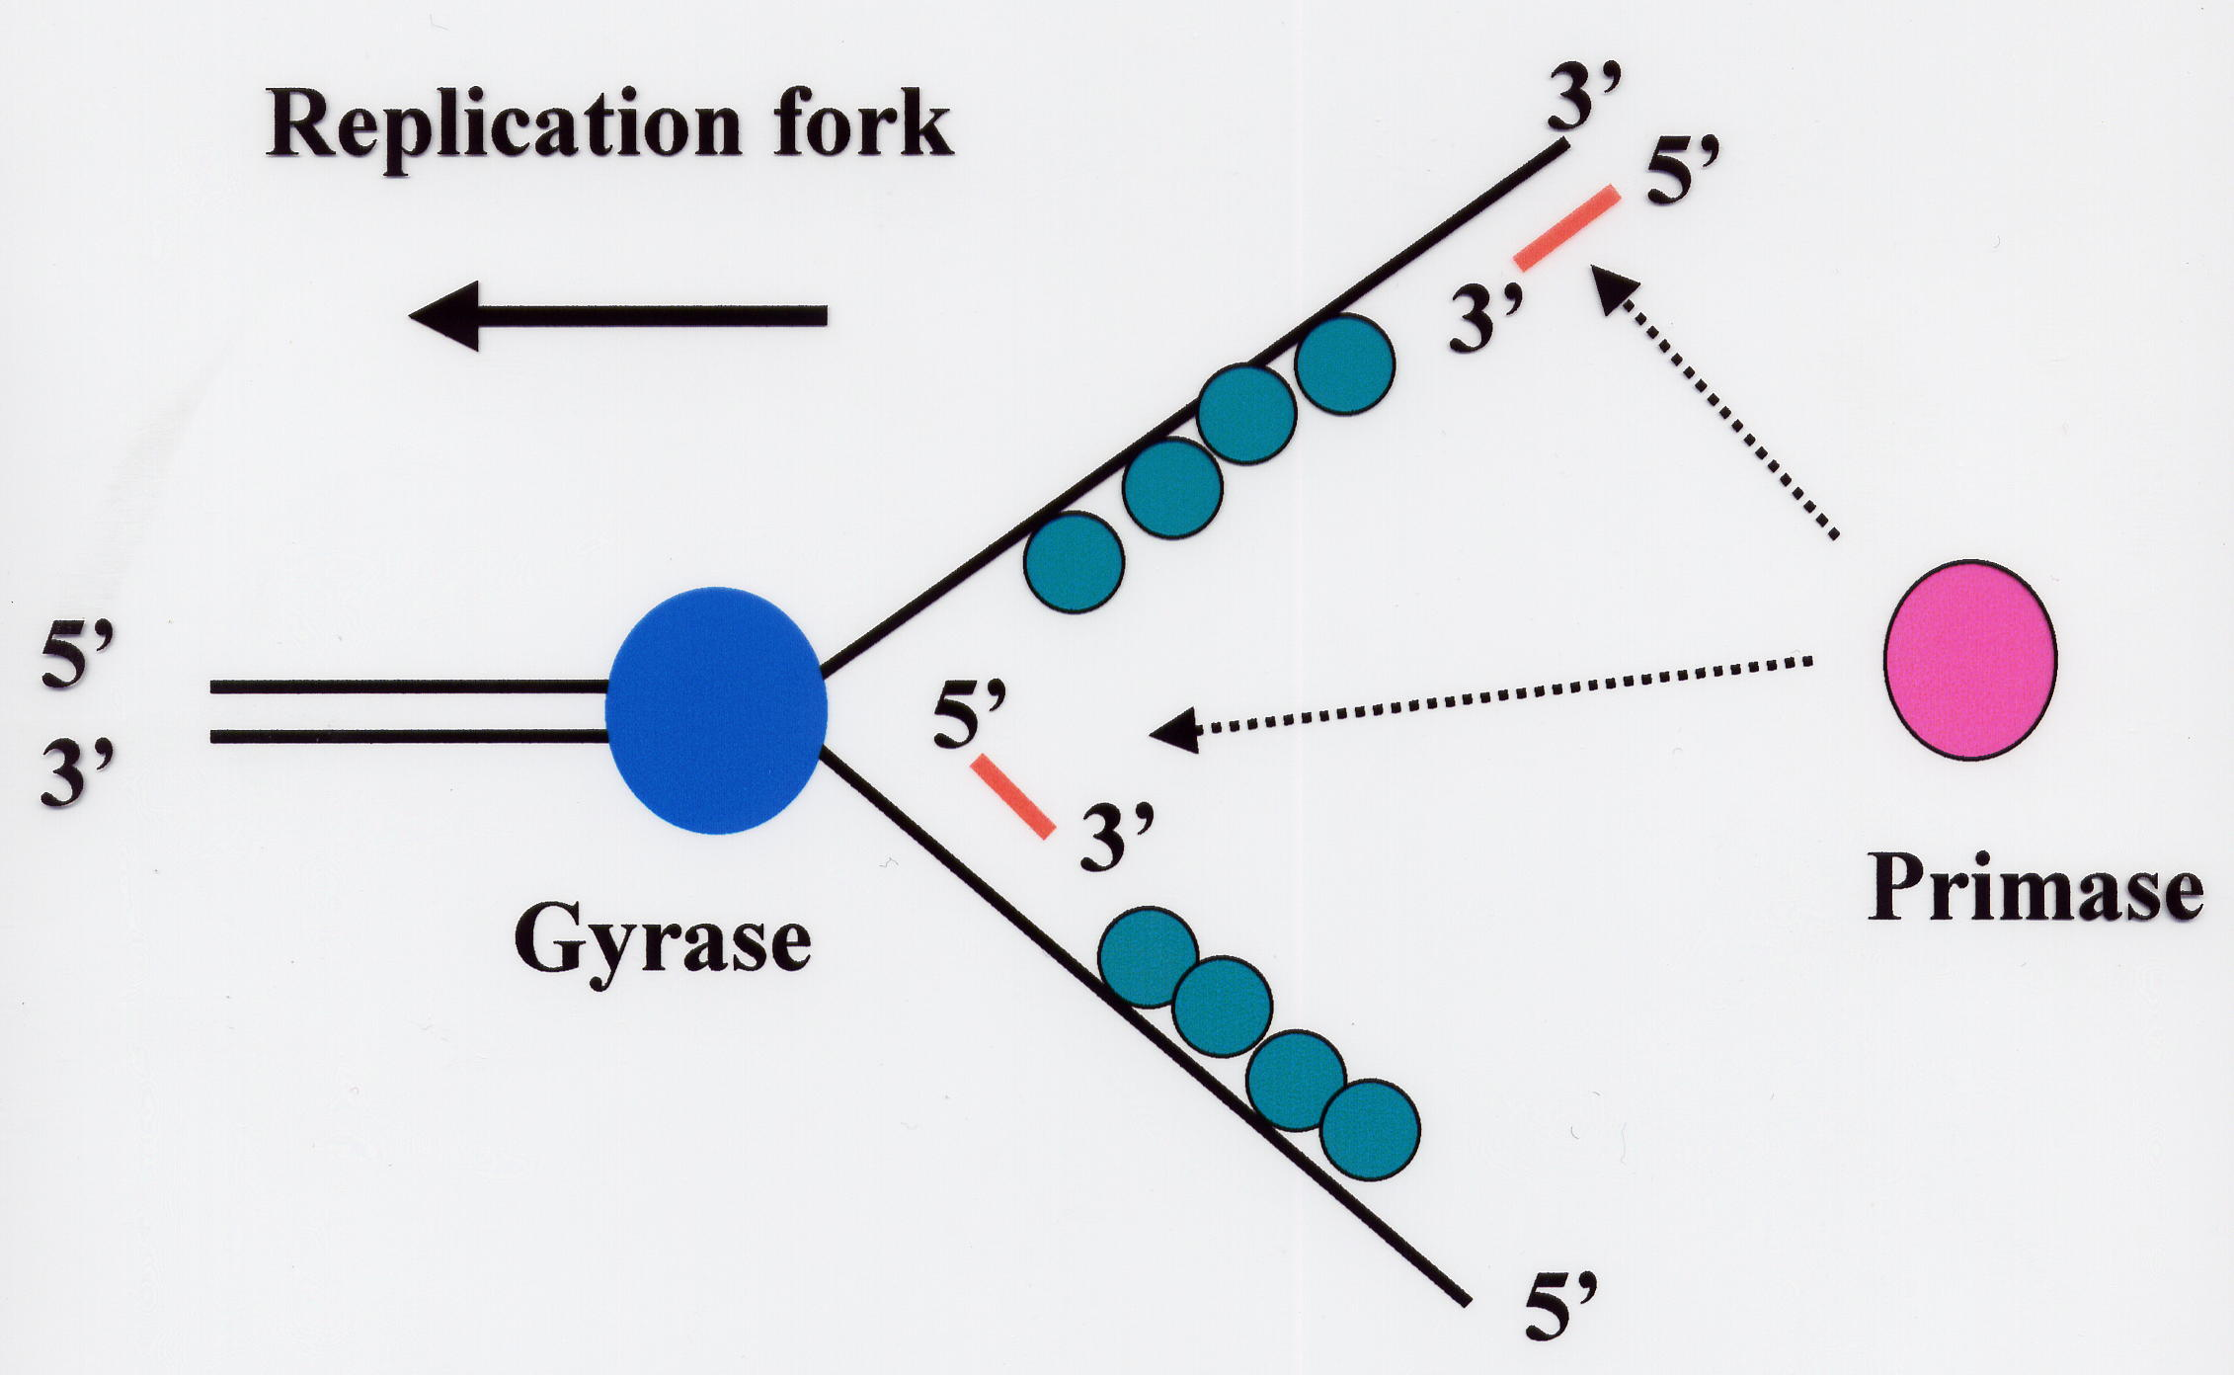
SSB
DnaB
E. Coli: DnaG

Slide 13
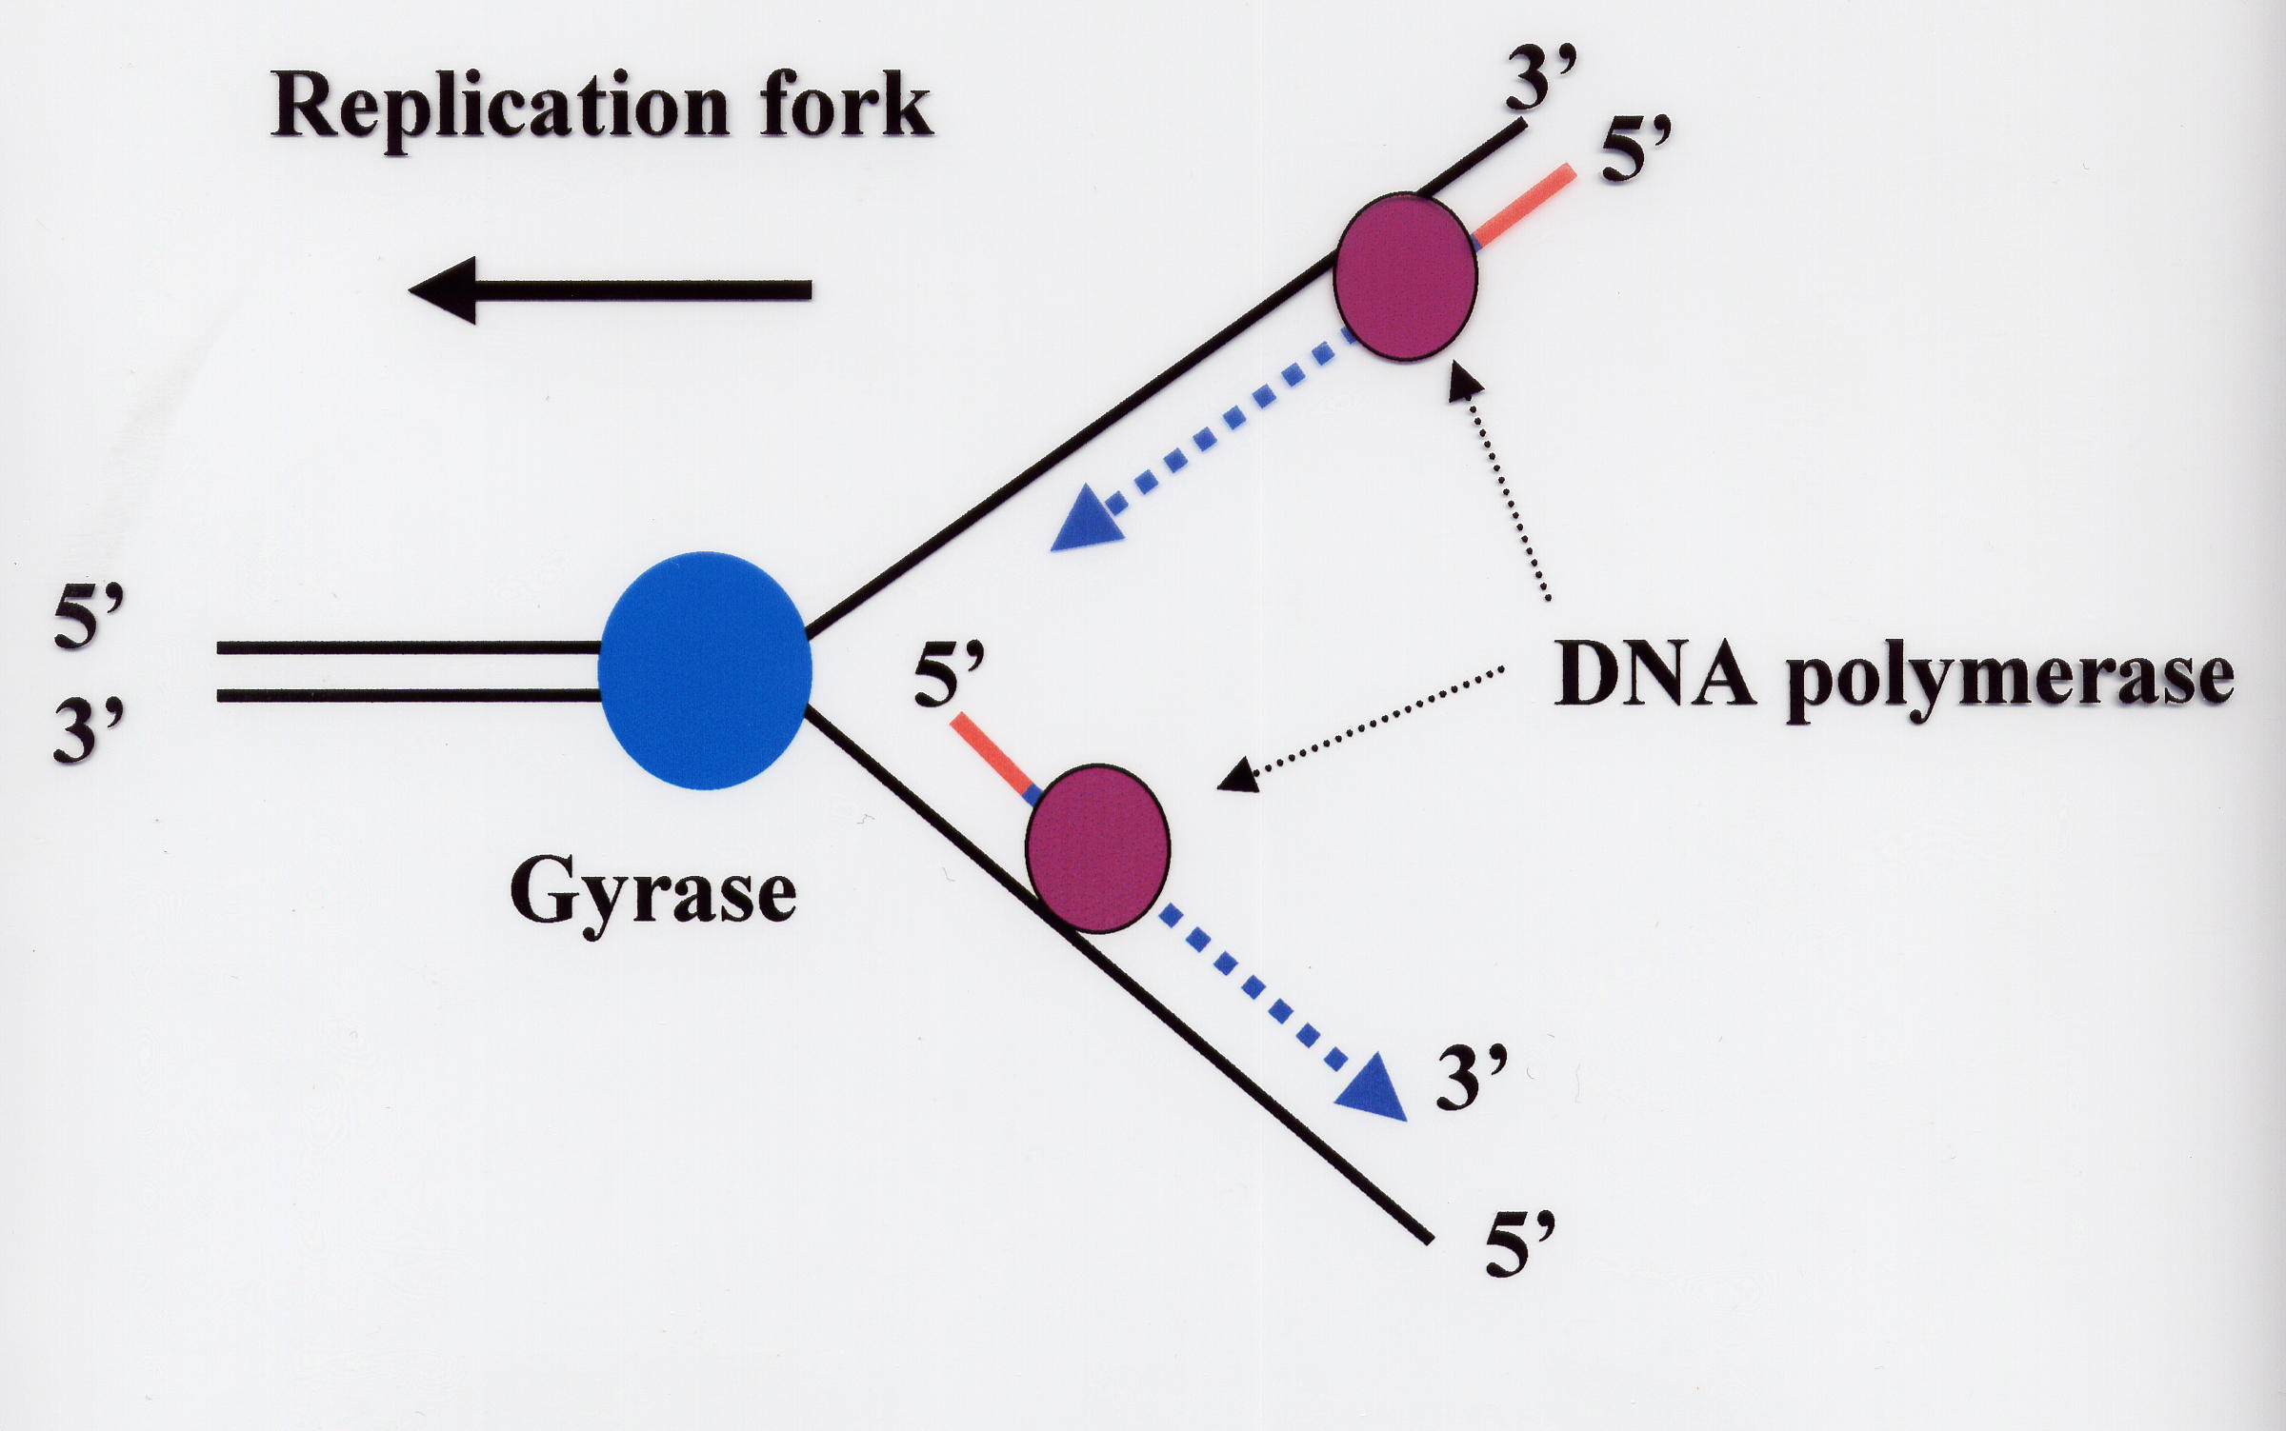
DnaB

Slide 14
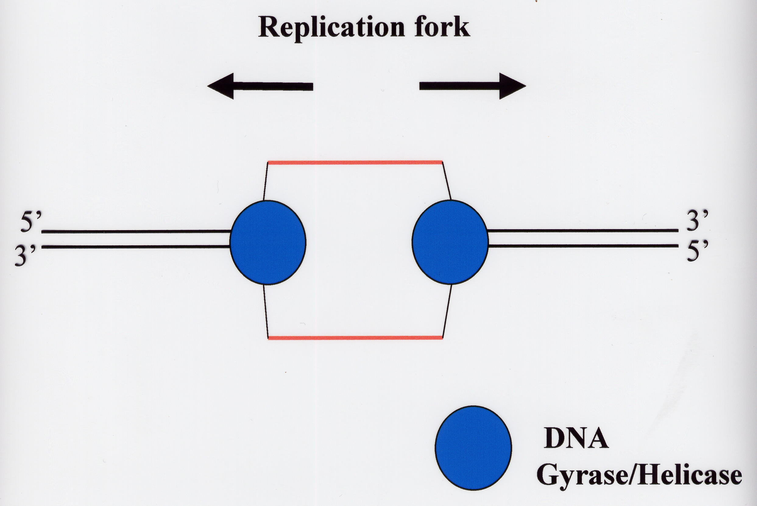

Slide 15
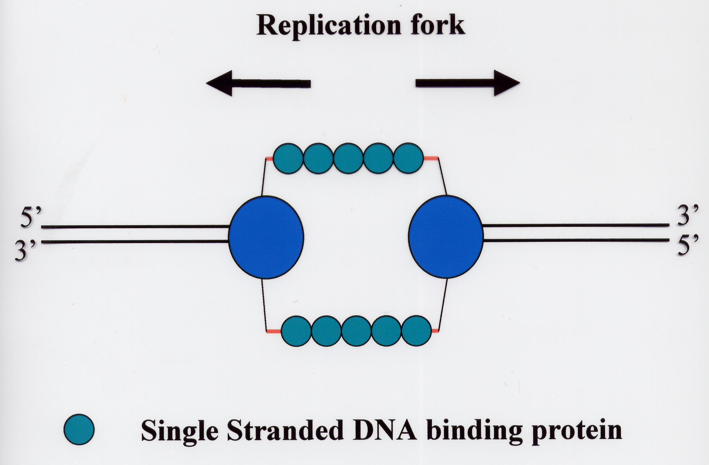
(SSB)

Slide 16
Replication Enzymes
DNA Polymerase - Matches the correct nucleotides then joins adjacent nucleotides to each other
Primase - Provides an RNA primer to start polymerization
Ligase - Joins adjacent DNA strands together (fixes “nicks”)

Slide 17
Helicase - Unwinds the DNA and melts it
Single Strand Binding Proteins - Keep the DNA single stranded after it has been melted by helicase
Gyrase - A topisomerase that Relieves torsional strain in the DNA molecule
Telomerase - Finishes off the ends of DNA strands

Slide 18
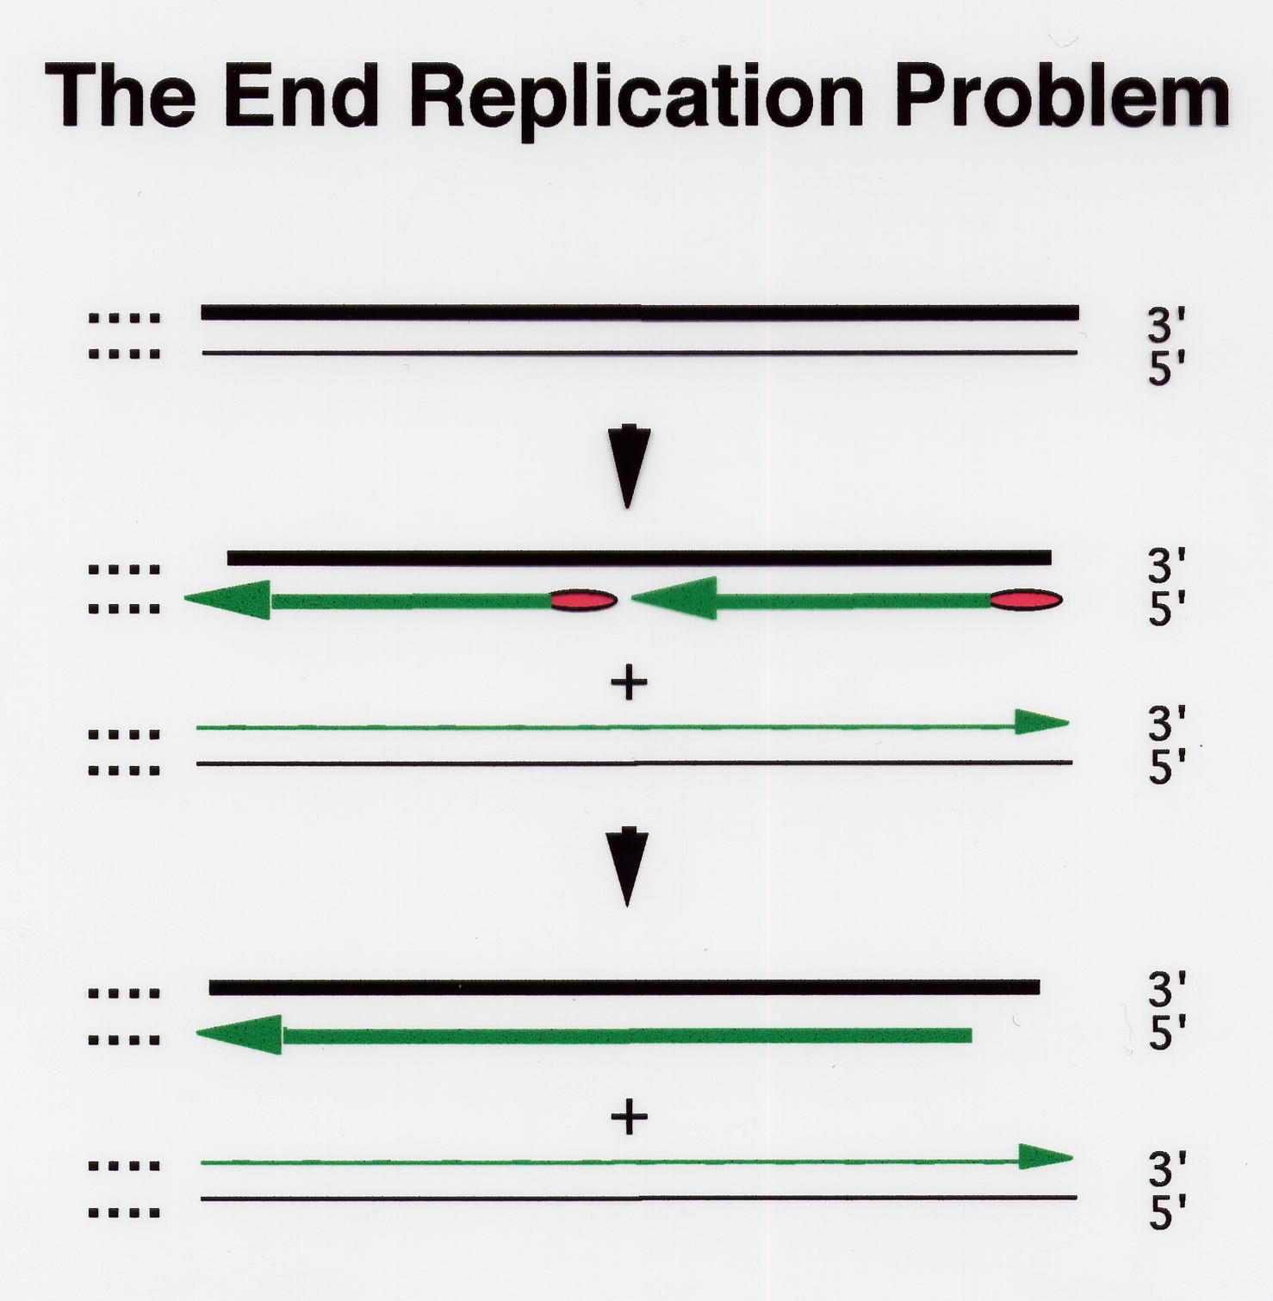

Slide 19
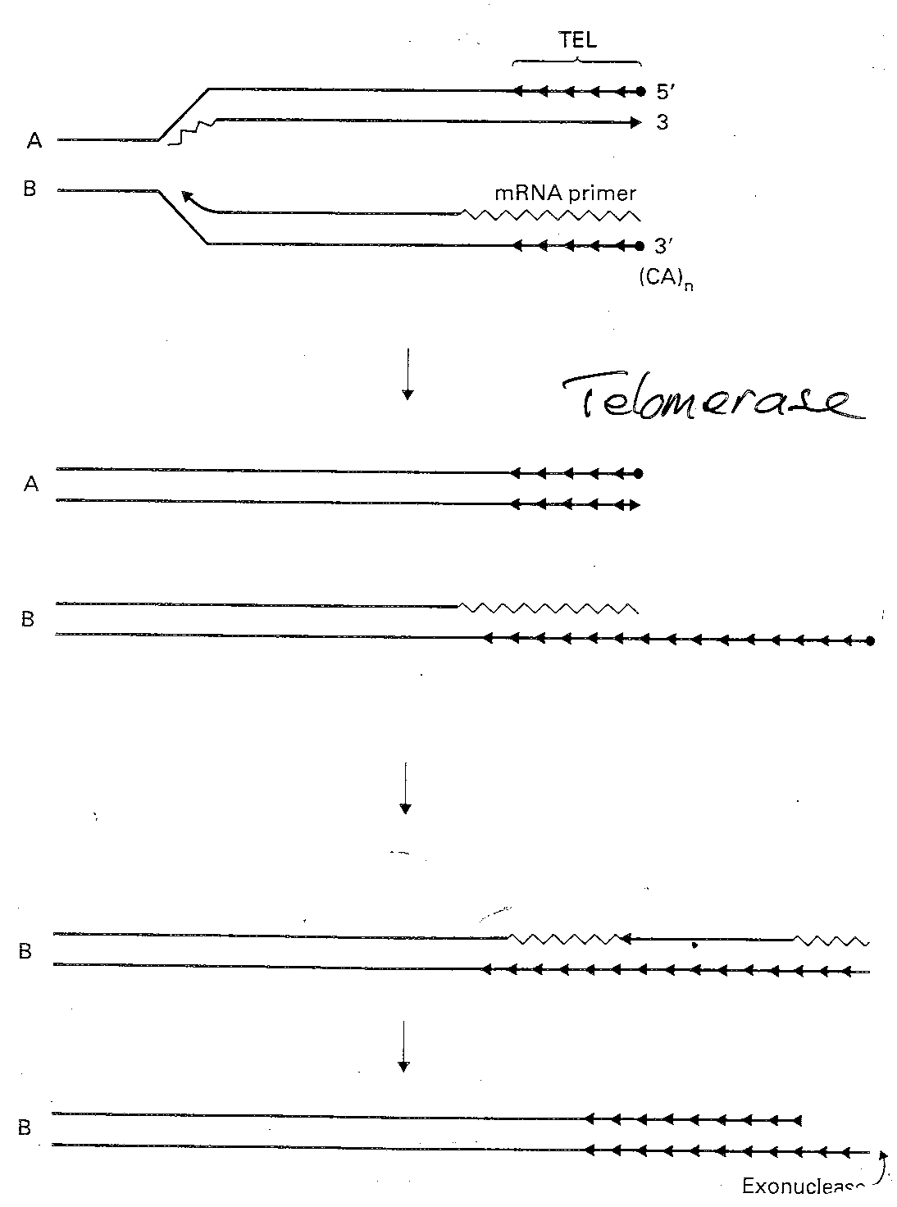

Slide 20
exonuclease

Slide 24
Eukaryotes vs Prokaryotes
Enzymology, fundamental features, replication fork geometry, and use of multiprotein machinery conserved
More protein components in Euk replication machinery
Replication must proceed through nucleosomes
Replication fork moves 10X faster in Prok.

Slide 25
REPLICATION – GENERAL PRINCIPLES
START
FINISH
ACCURACY/FIDELITY

Slide 26
Accuracy and Fidelity Maintenance of DNA Sequences

Slide 27
Maintenance of DNA Sequences
DNA Polymerase as Self Correcting Enzyme
Correct nucleotide has greater affinity for moving polymerase than incorrect nucleotide
Exonucleolytic proofreading of DNA polymerase
DNA molecules w/ mismatched 3’ OH end are not effective templates; polymerase cannot extend when 3’ OH is not base paired
DNA polymerase has separate catalytic site that removes unpaired residues at terminus

Slide 28
Maintenance of DNA Sequences
DNA Polymerase as Self Correcting Enzyme
Two catalytic sites

Slide 29
Strand Directed Mismatch Repair System
Removes replication errors not recognized by replication machine
Detects distortion in DNA helix
Distinguishes newly replicated strand from parental strand by methylation of A residues in GATC in bacteria
Methylation occurs shortly after replication occurs
Reduces error rate 100X
3 Step Process
recognition of mismatch
excision of segment of DNA containing mismatch
resynthesis of excised fragment

Slide 30
Strand Directed Mismatch Repair in Mammals
Newly synthesized strand is preferentially nicked and can be distinguish in this manner from parental strand
Defective copy of mismatch repair gene predisposed to cancer

Slide 31
Strand Directed Mismatch Repair System

Slide 32
Causes of DNA Damage
Chemical mutagens
Radiation
Free radicals

Slide 33
RADIATION = ENERGY
ENERGY DEPOSITION IN DNA
DNA DAMAGE

Slide 34
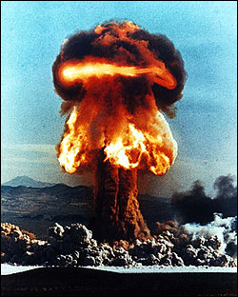
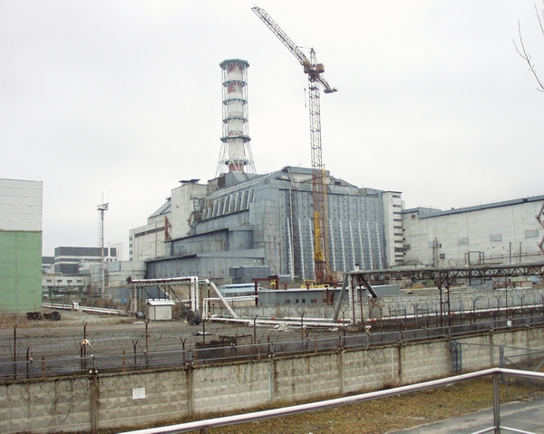

Slide 35
RADIOLYSIS OF WATER
.
.
H₂O OH + H + e⁻
.
S-A…….T-S
P P
S-A…….T-S
P
A-S
P
C-S
P
G-S
P
S
P
S-A…….T-S
P P
S-A…….T-S
P P
S-T…… A-S
P P
S-G……C-S
P P
S-C….....G-S
P P
S-T……..A-S
P P
S-A……..T-S
P P
OH
P
S
P
S-G
P
S-C
P
S-T
P
S-A……..T-S
P P
.
OH

Slide 36
RESPIRATION AND AGEING
Carbohydrate + O₂
Energy + CO₂ + H₂O
.
.
0₂ H₂O₂ OH
DNA damage
~10000 lesions/cell/day

Slide 37
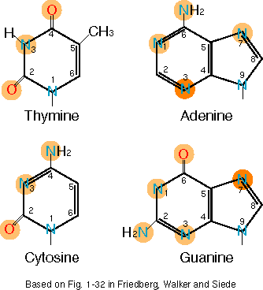
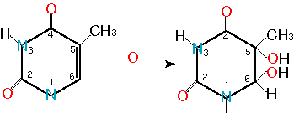
DNA Repair Types of DNA Damage: Base Loss and Base Modification
Chemical Modification
Photodamage thymine dimer
Depurination
Deamination
Chemical Modification by O2 free radicals

Slide 38
DNA Repair
Despite 1000’s of alterations that occur in DNA each day, few are retained as mutations
Efficient repair mechanisms
Importance of DNA repair highlighted by:
Number of genes devoted to DNA repair
↑ mutation rates with inactivation or loss of DNA repair gene
Defects in DNA repair associated with several disease states

Slide 39
DNA replication and repair disorders
Disorder | Frequency | Defect
Fanconi’s anaemia | 1/22,000 in some popns. | Deficient excision repair
Hereditary nonpolyposis colon cance | 1/200 | Deficient mismatch repair
Werner’s syndrome | 3/1,000,000 | Deficient helicase
Xeroderma pigmentosum | 1/250,000 | Deficient excision repair

Slide 40
DNA Repair
DNA Damage Can Activate Expression of Whole Sets of Genes
Heat Shock Response
SOS Response

Slide 41
DNA Repair

Slide 42
DNA Repair
Base Excision Repair
DNA glycosylase recognizes damaged base
Removes base leaving deoxyribose sugar
AP endonuclease cuts phosphodiester backbone
DNA polymerase replaces missing nucleotide
DNA ligase seals nick

Slide 44
Failure of DNA repair
When DNA repair fails, fewer mutations corrected → increase in number of mutations in the genome.
The protein p53 monitors repair of damaged DNA.
If damage too severe, p53 protein promotes programmed cell death (apoptosis)
Mutations in genes encoding DNA repair proteins can be inherited → overall increase in mutations as errors or damage to DNA no longer repaired efficiently.

Slide 45
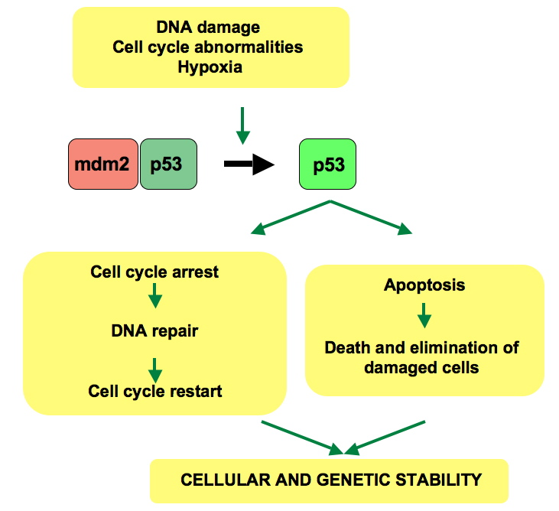

Slide 46
DNA DAMAGE
SURVEILLANCE
RECOGNITION
SIGNALLING
REPAIR

