Slide 1
Thermodynamics
(Module -4)
B.Sc. III Year
SAIKRISHNA UGGU
Lecturer in Chemistry
P. R. Govt. College (A)
KAKINADA

Slide 2
Contents…
Variation of heat of a reaction with temperature
Kirchoffs equation

Slide 3
Kirchhoff’s equation
Variation of Heat off a reaction or Enthalpy of formation with temperature is given by Kirchhoff’s equation

Slide 4
Kirchhoff’s equation
The amount of heat evolved or absorbed in a process, varies with temperature. The exact relationship showing the variation of the heat of reaction with temperature was given by Kirchhoff in 1858

Slide 5
Kirchhoff’s equation
Statement: The change in the heat of a reaction at constant pressure for every degree change of temperature is equal to the change in the heat capacity at constant pressure.

Slide 6
Kirchhoff’s equation
Mathematically it is expressed as follows,
$$\frac{ΔH2− ΔH1}{T2−T1}= ΔCp$$

Slide 7
Kirchhoff’s equation
It can be derived easily with the help of the first law of thermodynamics.
Consider the simple process,
A _{(reactants)} ----------→ B _{(products)}

Slide 8
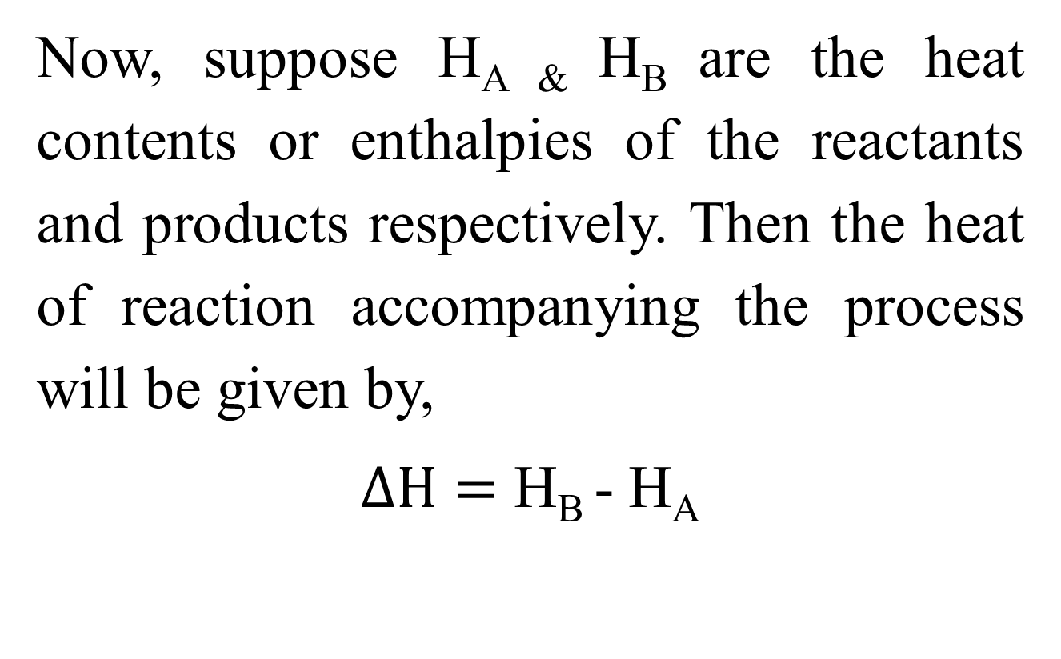
Kirchhoff’s equation
Now, suppose H_{A &} H_{B} are the heat contents or enthalpies of the reactants and products respectively. Then the heat of reaction accompanying the process will be given by,
$ΔH=$ H_{B} - H_{A}

Slide 9
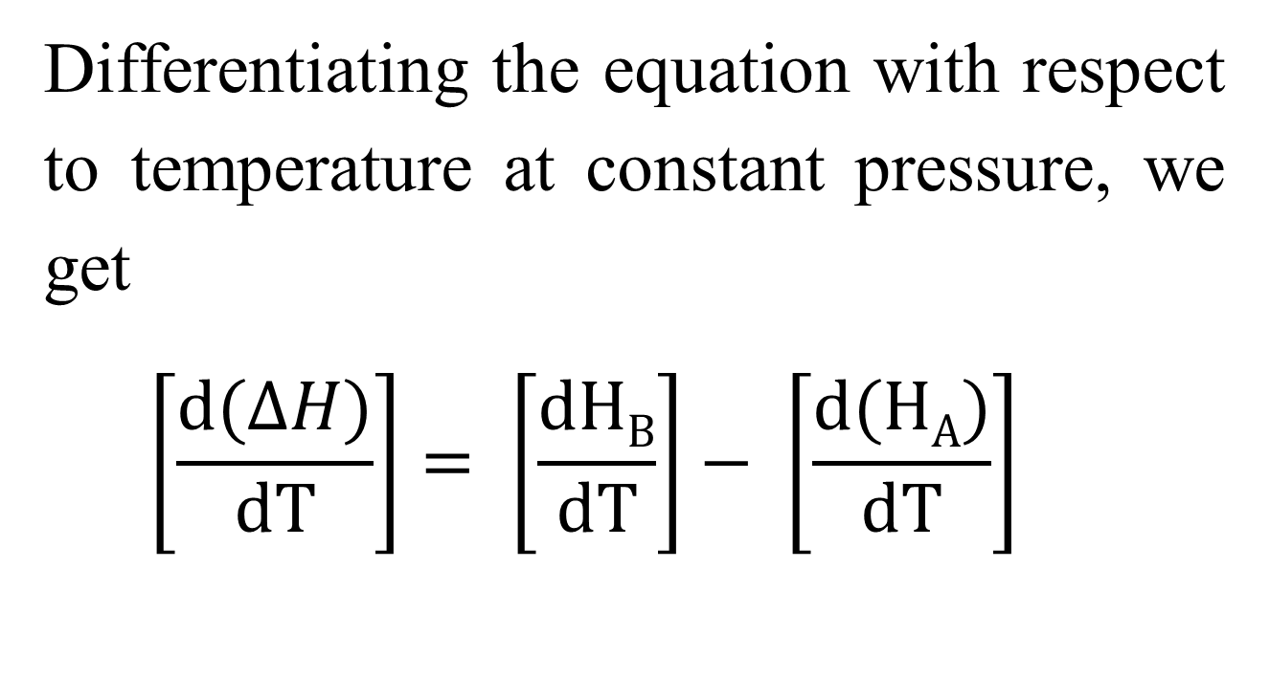
Kirchhoff’s equation
Differentiating the equation with respect to temperature at constant pressure, we get
$$\left[\frac{d(ΔH)}{dT}\right]= \left[\frac{dHB}{dT}\right]− \left[\frac{d(HA)}{dT}\right]$$

Slide 10
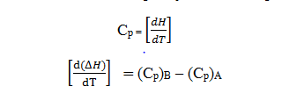
Kirchhoff’s equation
According to the definition of heat capacity at constant pressure,

Slide 11
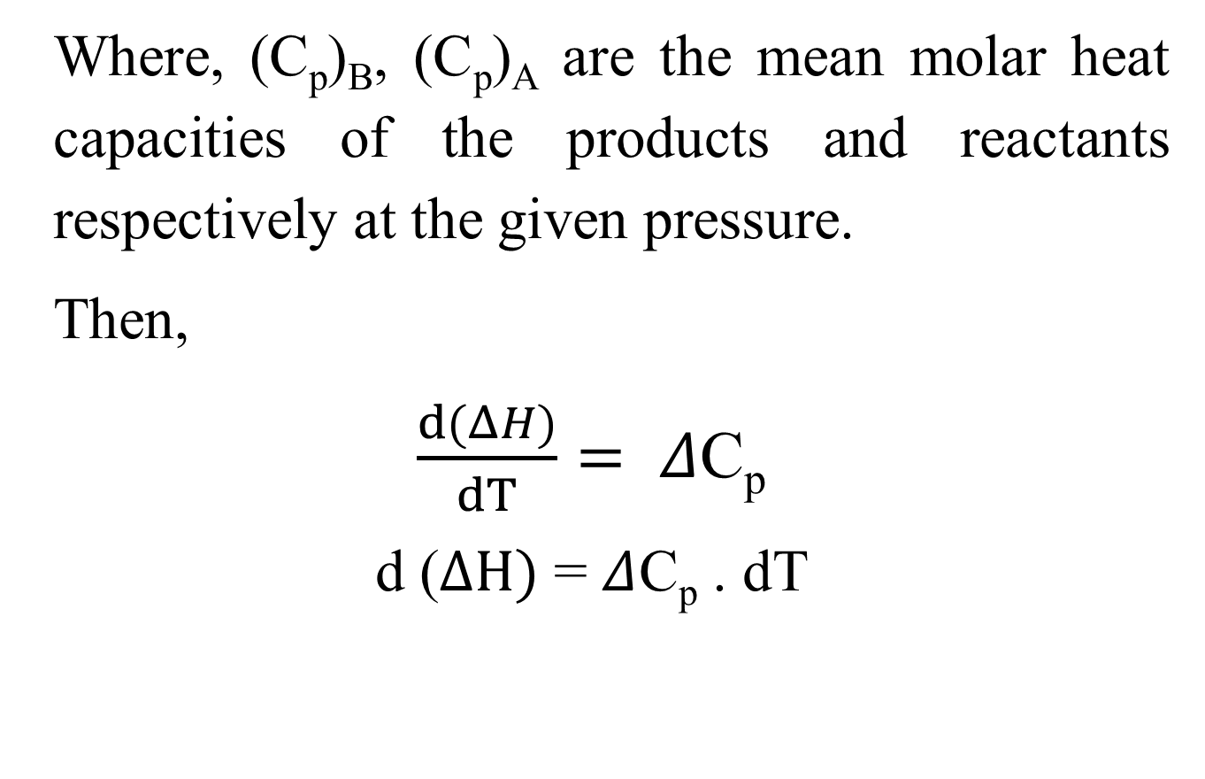
Kirchhoff’s equation
Where, (C_{p})_{B}, (C_{p})_{A} are the mean molar heat capacities of the products and reactants respectively at the given pressure.
Then,
$\frac{d(ΔH)}{dT}= Δ$C_{p}
d ($ΔH)$ = $Δ$C_{p} . dT

Slide 12
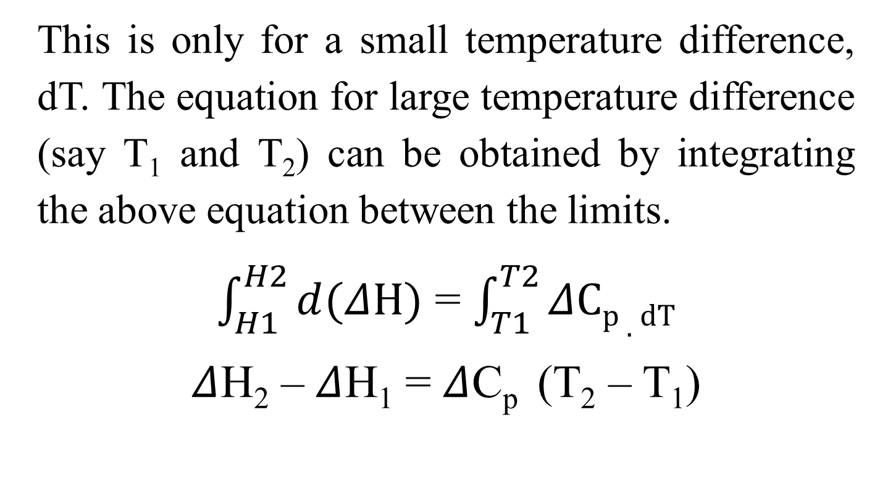
Kirchhoff’s equation
This is only for a small temperature difference, dT. The equation for large temperature difference (say T₁ and T₂) can be obtained by integrating the above equation between the limits.
$\int_{H1}^{H2}{d(ΔH)}$ = $\int_{T1}^{T2}{ΔCp . dT}$
$Δ$H₂ – $Δ$H₁ = $Δ$C_{p} (T₂ – T₁)

Slide 13
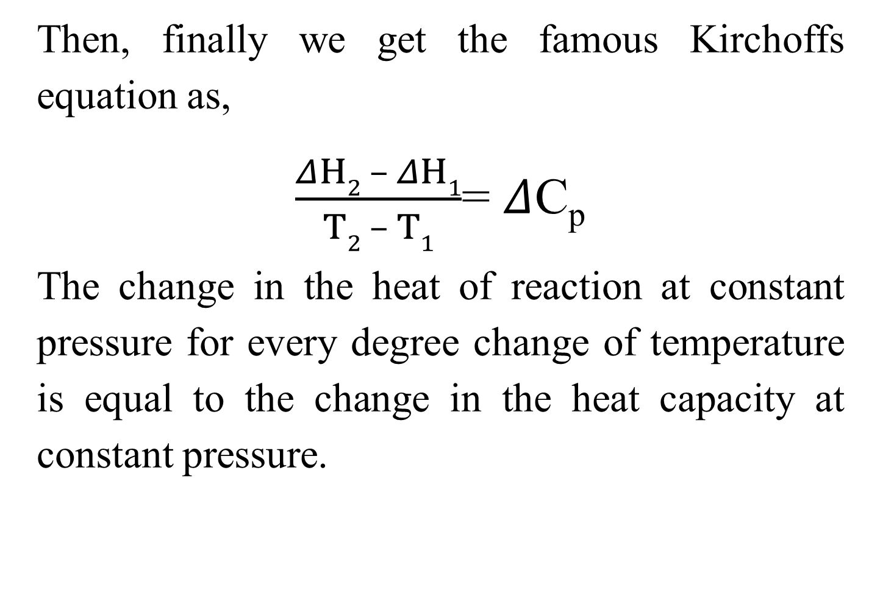
Kirchhoff’s equation
Then, finally we get the famous Kirchoffs equation as,
$\frac{ΔH2 – ΔH1}{T2 – T1}$= $Δ$C_{p}
The change in the heat of reaction at constant pressure for every degree change of temperature is equal to the change in the heat capacity at constant pressure.

Slide 14
Thank You……

