Slide 1
Thermodynamics
(Module - 5)
B.Sc. III Year
SAIKRISHNA UGGU
Lecturer in Chemistry
P. R. Govt. College (A)
KAKINADA

Slide 2
Contents…
Second law of thermodynamics
The Carnot cycle
Entropy

Slide 3
Second law of thermodynamics
The important limitation of first law of thermodynamics is that, it does not state whether a reaction is spontaneous or not and in which direction it will occur.

Slide 4
Second law of thermodynamics
Second law of thermodynamics is concerned with the direction and spontaneity of processes. It can be defined in several ways.

Slide 5
Second law of thermodynamics
All spontaneous processes are thermodynamically irreversible.
A process which proceeds of its own accord, without the help of any external agency is called a spontaneous process.

Slide 6
Second law of thermodynamics
Clausius statement: Heat cannot itself pass from a colder body (low temperature region) to a hotter body (High temperature region) without use of any external agency.

Slide 7
Second law of thermodynamics
Kelvin – Planck statement: It is impossible to convert heat completely into equivalent amount of work without producing changes elsewhere.
No heat engine has a 100% thermal efficiency

Slide 8
Second law of thermodynamics
Kelvin – Planck statement: It is impossible to convert heat completely into equivalent amount of work without producing changes elsewhere.
No heat engine has a 100% thermal efficiency

Slide 9
The Carnot Cycle
Carnot proposed a hypothetical heat engine to show that the efficiency of a heat engine is based upon the temperature between which it operates.

Slide 10
The Carnot Cycle
Carnot engine has following features,
It consists of a cylinder containing one mole of an ideal gas and fitted with a weightless, frictionless piston so that all the operations in the cycle are carried out reversibly.

Slide 11
The Carnot Cycle
The cylinder is assumed to be insulated on all sides except at the bottom so that heat can flow from or to the system only through the bottom.

Slide 12
The Carnot Cycle
The engine has two heat reservoirs, one at a higher temperature T₂ called the source and the other at a lower temperature T₁ called the sink.

Slide 13
The Carnot Cycle
Operations are carried out in Carnot cycle are two ways:
1. Isothermal process
2. Adiabatic processes.

Slide 14
The Carnot Cycle
The complete Carnot cycle consists of four operations. These are represented on P – V diagram or indicator diagram.

Slide 15
The Carnot Cycle
Isothermal reversible expansion
Adiabatic reversible expansion
Isothermal reversible compression
Adiabatic reversible compression

Slide 16
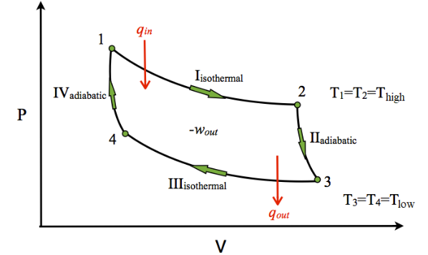
The Carnot Cycle

Slide 17
The Carnot Cycle
Isothermal expansion: The cylinder containing one mole of the ideal gas, occupying a volume V₁, is placed in contact with the heat reservoir at a temperature T₂ (Source).The gas absorbs heat (say Q₂) from the source and expands isothermally and reversibly to volume V_{2.}

Slide 18
The Carnot Cycle
Isothermal expansion:
Work done in this process is,
W₁ = Q₂
W₁ = Q₂ = RT₂ ln(V₂/V₁)

Slide 19
The Carnot Cycle
Adiabatic expansion: The cylinder is removed from the source and placed in contact with the perfectly insulating material. Thus, the gas now expands adiabatically and reversibly from volume V₂ to V₃. Work is done in the expansion but since no heat enters or leaves the system, the temperature must fall and suppose it drops to T₁ (Temp of sink).

Slide 20
The Carnot Cycle
Adiabatic expansion:
Work done by the system = W₂
Heat absorbed by the system = 0
Now, from first law,
ΔE = - W₂
But we know that,
ΔE = C_{v} (T₂ – T₁)
Hence,
W₂ = C_{v} (T₂ – T₁)

Slide 21
The Carnot Cycle
Isothermal compression: The cylinder is now removed from the insulating material and placed in contact with the second heat reservoir at a lower temperature T₁ (sink).

Slide 22
The Carnot Cycle
Isothermal compression:
Since the compression takes place isothermally, ΔE = 0. Thus if Q₁ is the heat given to the sink at temperature T₁ and W₃ is the work done on the system, then
Q₁ ₌ W₃ = RT₁ ln (V₄/V₃)

Slide 23
The Carnot Cycle
Adiabatic compression: The cylinder is now removed from the sink and placed again on the insulating material. The gas compressed adiabatically and reversibly from volume V₄ to the original volume V₁ while the temperature rises from T₁ to the original temperature T₂.

Slide 24
The Carnot Cycle
Adiabatic compression:
Work done on the system = -W₄
ΔE = Q – (-W₄)
ΔE = W₄ = C_{v} (T₂ – T₁)
W₄ = - C_{v} (T₂ – T₁)

Slide 25
The Carnot Cycle
Net work done in one cycle: The net work done in one cycle is obtained by adding the work done in the four processes.
W = W₁ + W₂ + (-W₃ ) + (-W₄ )
W = RT₂ ln(V₂/V₁) + C_{v} (T₂ – T₁) + RT₁ ln (V₄/V₃) - C_{v} (T₂ – T₁)
W = RT₂ ln(V₂/V₁) + RT₁ ln (V₄/V₃)

Slide 26
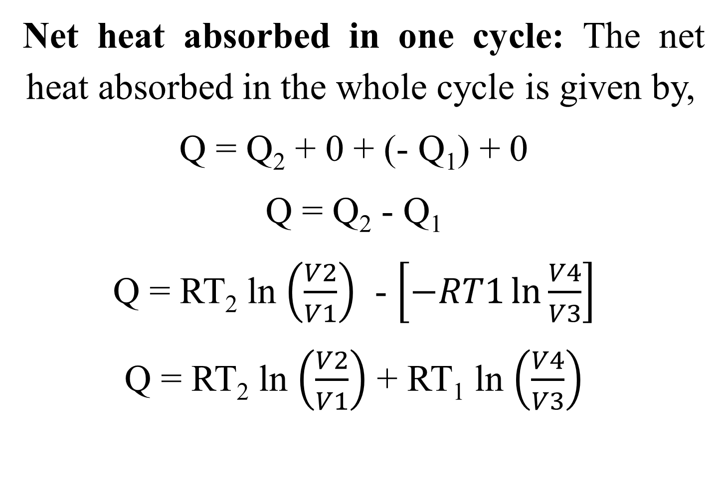
The Carnot Cycle
Net heat absorbed in one cycle: The net heat absorbed in the whole cycle is given by,
Q = Q₂ + 0 + (- Q₁) + 0
Q = Q₂ - Q₁
Q = RT₂ ln $\left(\frac{V2}{V1}\right)$ - $\left[−RT1\ln{\frac{V4}{V3}}\right]$
Q = RT₂ ln $\left(\frac{V2}{V1}\right)$ + RT₁ ln $\left(\frac{V4}{V3}\right)$

Slide 27

The Carnot Cycle
Since, V₁ and V₄ lie on the same adiabatic curve and for adiabatic change,
${T{V}}^{γ−1}$ = Constant
(V₄ /V₁) ^{(Γ-1)} = T₂ / T₁

Slide 28
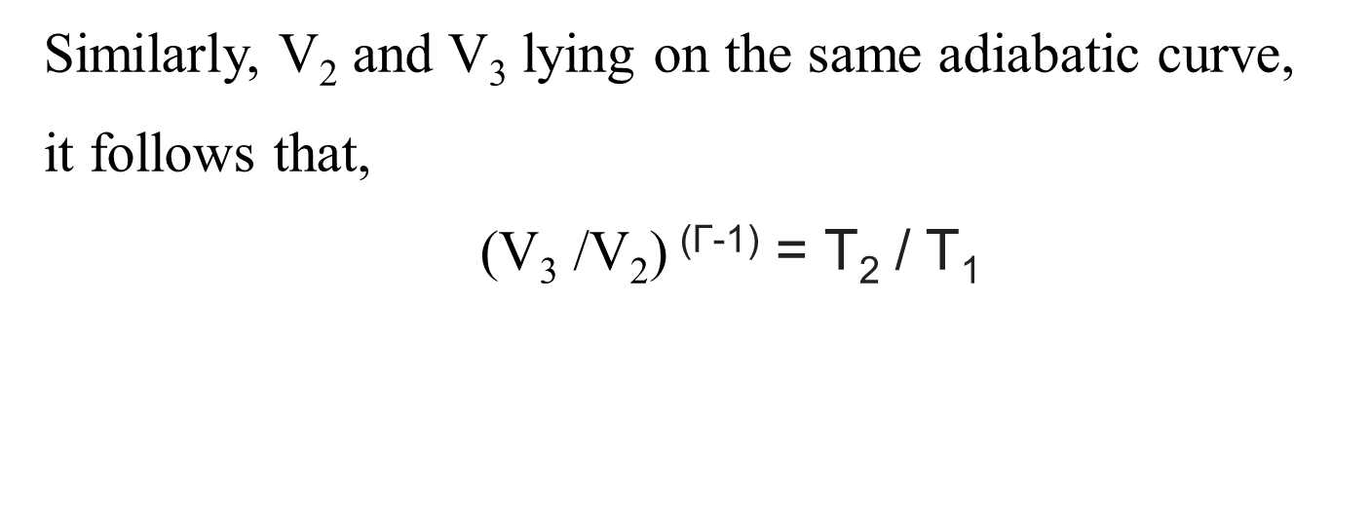
The Carnot Cycle
Similarly, V₂ and V₃ lying on the same adiabatic curve,
it follows that,
(V₃ /V₂) ^{(Γ-1)} = T₂ / T₁

Slide 29

The Carnot Cycle
Therefore,
(V₄ /V₁) ^{(Γ-1)} = (V₃ /V₂) ^{(Γ-1)}
$\frac{V4}{V1}$ = $\frac{V3}{V2}$
V₄ / V₃ = V₁ / V₂

Slide 30
The Carnot Cycle
Now,
W = W = RT₂ ln(V₂/V₁) + RT₁ ln (V₄/V₃)
W = RT₂ ln(V₂/V₁) + RT₁ ln (V₁/V₂)
W = RT₂ ln(V₂/V₁) - RT₁ ln (V₂/V₁)
W = R(T₂ – T₁) ln(V₂/V₁)

Slide 31
The Carnot Cycle
Efficiency of a heat engine: The fraction of the heat absorbed by a machine that it can be transform into work is called efficiency of the engine. It is expressed as,
η = W / Q

Slide 32
The Carnot Cycle
Efficiency of a heat engine:
Hence,
η = W / Q₂
η = (T₂ – T₁) / T₂ = (Q₂ – Q₁) / Q₂
η = 1 – (T₁ / T₂)

Slide 33
ENTROPY
Entropy:
Entropy is regarded as a measure of the disorder or randomness of a system. More disordered system having higher entropy.
All spontaneous processes lead to an increase in entropy.

Slide 34
ENTROPY
Entropy is a definite quantity and its value is independent of the path taken for the change and depends only upon the initial and final states of the system, hence entropy is a state function.

Slide 35

ENTROPY
The change in entropy of the system is defined as the quantity of heat absorbed isothermally and reversibly divided by the absolute temperature at which heat is absorbed.
ΔS = $\frac{Q}{T}$

Slide 36
ENTROPY
Entropy change in a reversible process:
In a thermodynamically reversible process, the entropy of the system and its surroundings remains constant.

Slide 37
ENTROPY
Consider a process occurring completely reversible conditions. If Q_{rev} is the heat absorbed reversibly by the system and then Q_{rev} will be the heat lost by the surroundings.

Slide 38
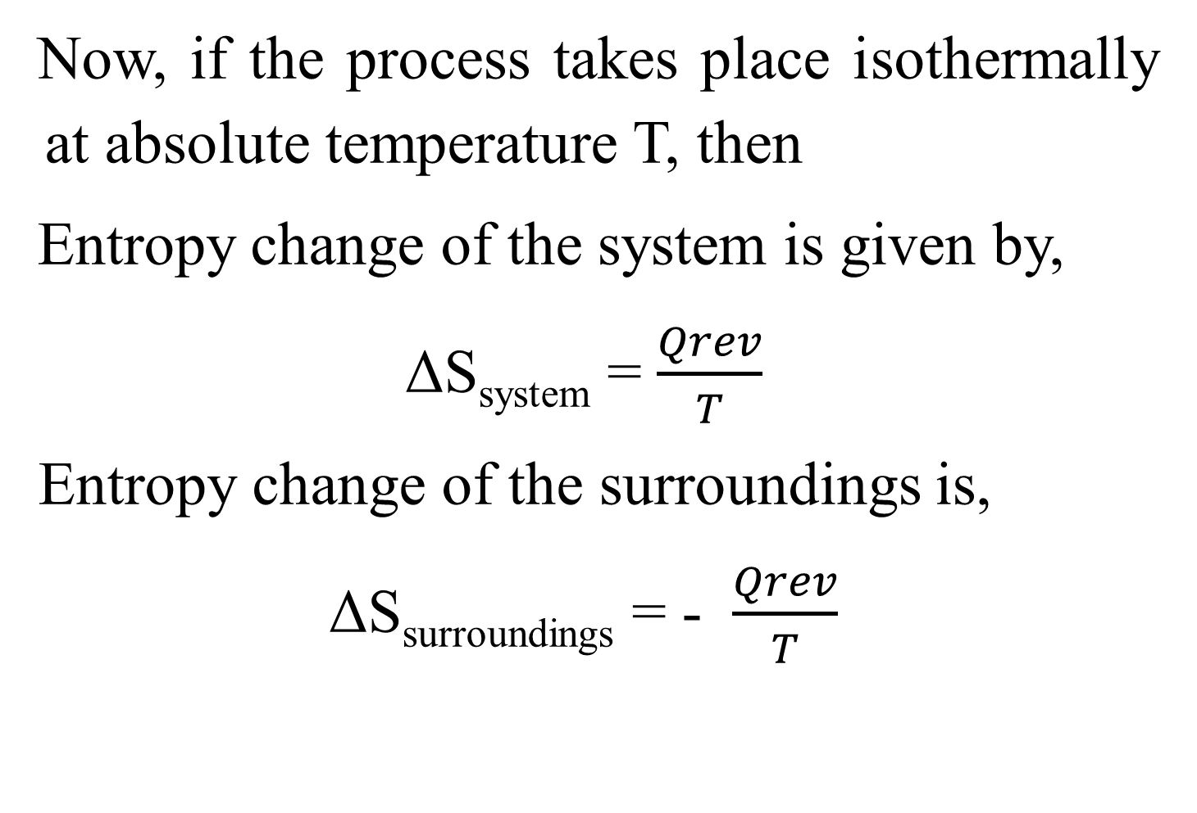
ENTROPY
Now, if the process takes place isothermally at absolute temperature T, then
Entropy change of the system is given by,
ΔS_{system} = $\frac{Qrev}{T}$
Entropy change of the surroundings is,
ΔS_{surroundings} = - $\frac{Qrev}{T}$

Slide 39
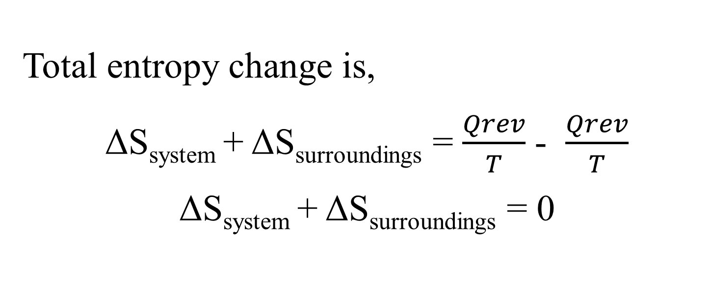
ENTROPY
Total entropy change is,
ΔS_{system} + ΔS_{surroundings} = $\frac{Qrev}{T}$ - $\frac{Qrev}{T}$
ΔS_{system} + ΔS_{surroundings} = 0

Slide 40
ENTROPY
Thus, in a reversible process, the net entropy change for the combined system and the surroundings is zero, i.e., in a thermodynamically reversible process, the entropy of the system and its surroundings remains constant.

Slide 41
ENTROPY
Entropy change in an irreversible process - Spontaneous process:
A thermodynamically irreversible process is accompanied by an increase in the entropy of the system and its surroundings.

Slide 42
ENTROPY
If any part of the process is irreversible, the process as a whole is irreversible. If the total heat lost by the surroundings is Q_{irrev} then the heat absorbed by the system will also be Q_{irrev} .

Slide 43
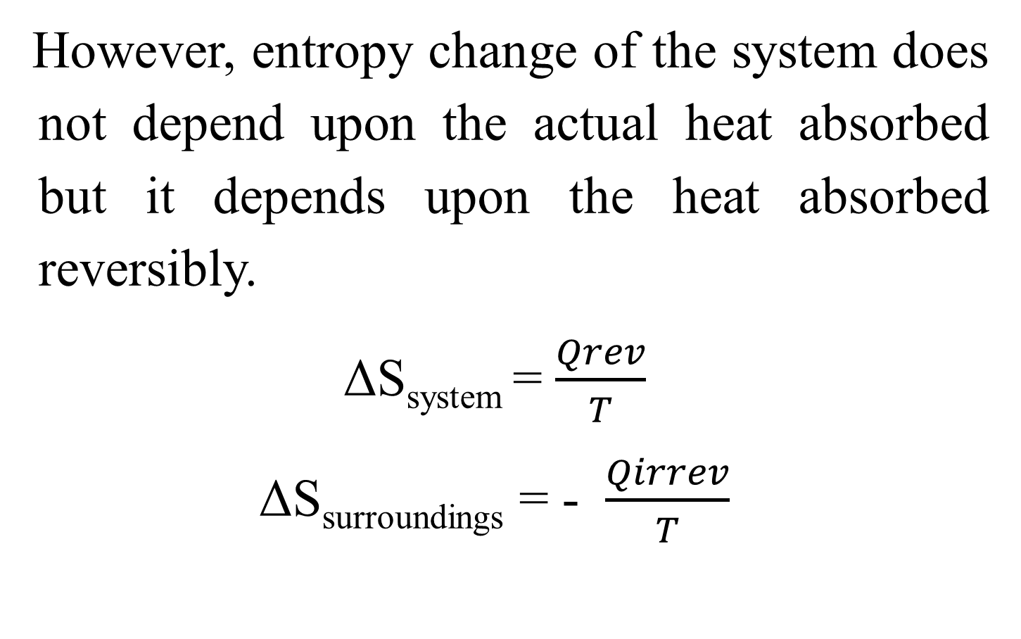
ENTROPY
However, entropy change of the system does not depend upon the actual heat absorbed but it depends upon the heat absorbed reversibly.
ΔS_{system} = $\frac{Qrev}{T}$
ΔS_{surroundings} = - $\frac{Qirrev}{T}$

Slide 44

ENTROPY
The total entropy change,
ΔS_{system} + ΔS_{surroundings} = $\frac{Qrev}{T}$ - $\frac{Qirrev}{T}$

Slide 45
ENTROPY
We know that, W_{rev} > W_{irrev} and hence
Q_{rev} > Q_{irrev}
$\frac{Qrev}{T}$ > $\frac{Qirrev}{T}$
$\frac{Qrev}{T}$ - $\frac{Qirrev}{T}$ > 0
ΔS_{system} + ΔS_{surroundings} > 0

Slide 46
ENTROPY
ΔS_{system} + ΔS_{surroundings} > 0
Thus, in an irreversible process, the entropy change for the combined system and the surroundings is greater than zero, i.e., a thermodynamically irreversible process is accompanied by an increase in the entropy of the system and its surroundings.

Slide 47
Thank You……

