Slide 1
Thermodynamics
(Module -2)
B.Sc. III Year
SAIKRISHNA UGGU
Lecturer in Chemistry
P. R. Govt. College (A)
KAKINADA

Slide 2
Contents…
Internal energy
Enthalpy
Heat capacities
Relation between Cp and Cv

Slide 3
Internal Energy
Every substance possesses a definite amount of energy which depends upon its chemical nature, temperature, pressure and volume.
This energy associated with every substance is called internal energy or intrinsic energy and is denoted by letter E or U.

Slide 4
Internal Energy
The internal energy of a substance or system is a definite quantity and its exact value cannot be determined because it involves certain quantities like translational, vibrational and rotational kinetic energies which cannot be measured.
E = E_{tr} + E_{rot} + E_{vib} + E_{ele} + E_{bon} + …..

Slide 5
Internal Energy
Internal energy is state function; therefore its change can be determined instead of its absolute value.
The change in internal energy of a system is,
ΔE = E₂ – E₁
Where, E₂ = Internal energy of the system at final stage and
E₁ = Internal energy of the system at initial stage

Slide 6
Internal Energy
If, E₁ > E₂ (E_{R} > E_{P} ), then the extra energy possessed by the system in the initial state would be given out and thus ΔE will be negative.
If, E₂ > E₁ (E_{P} > E_{R} ), energy will be absorbed in the process and ΔE will be positive.

Slide 7
Enthalpy
Heat content of a system at constant pressure is called Enthalpy. It is denoted by H.
The enthalpy of a substance or a system is the total amount of energy stored in that substance.

Slide 8
Enthalpy
Enthalpy of a system is a state function and therefore its change can be determined instead of its absolute value.
The enthalpy of a thermodynamic system is defined as,
H = E + PV
Where,
H is enthalpy is the internal energy of the system,
P is pressure, V is the volume of the system.

Slide 9
Change in enthalpy
The enthalpy change accompanying a process at constant pressure may be defined as the sum of the increase in internal energy of the system and the pressure – volume work (i.e. the work of expansion)
ΔH = ΔE + W

Slide 10
Change in enthalpy
The process where, H₂ > H₁, in exothermic process ΔH is negative,
While the process where, H₂ < H₁, in endothermic process ΔH is positive.

Slide 11
Heat Capacities
Heat Capacity: It is defined as the amount of heat required to rise the temperature of a substance by one unit temperature change. Heat capacity of a system means the capacity to absorb and store energy.
We can also write it as q = C ∆T, the coefficient, C is called the heat capacity.

Slide 12
Heat Capacities
Specific heat, also called specific heat capacity is the quantity of heat required to raise the temperature of one unit mass or 1 gram of a substance by one degree Celsius.

Slide 13

Heat Capacities
The molar heat capacity of a substance is the heat capacity for one mole of the substance and is the quantity of heat required to raise the temperature of one mole of a substance by one degree Celsius.
C_{m} = $\left(\frac{C}{n}\right)$

Slide 14
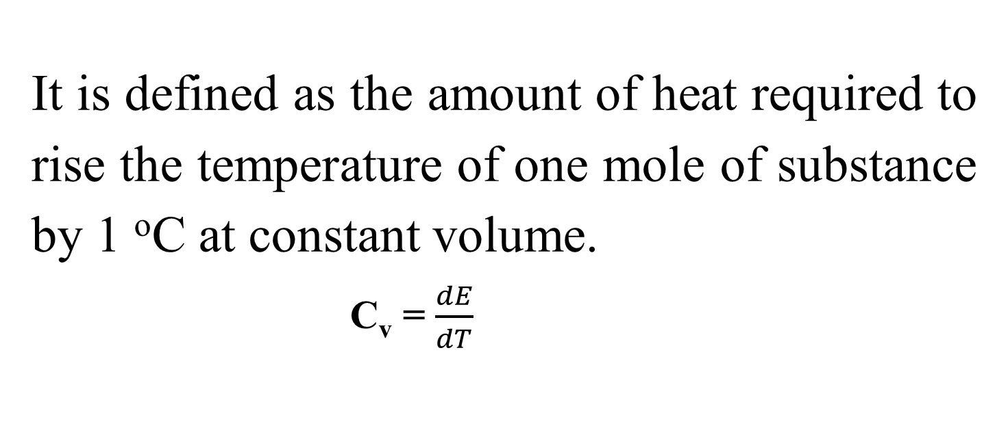
C_{V}: Molar heat capacity at constant volume
It is defined as the amount of heat required to rise the temperature of one mole of substance by 1 ºC at constant volume.
C_{v} = $\frac{dE}{dT}$

Slide 15
C_{V}: Molar heat capacity at constant volume
Heat capacity of a system at constant volume is defined as the increase in internal energy of the system per degree rise of temperature at constant volume. Or
It is the rate of change of internal energy with temperature at constant volume.

Slide 16
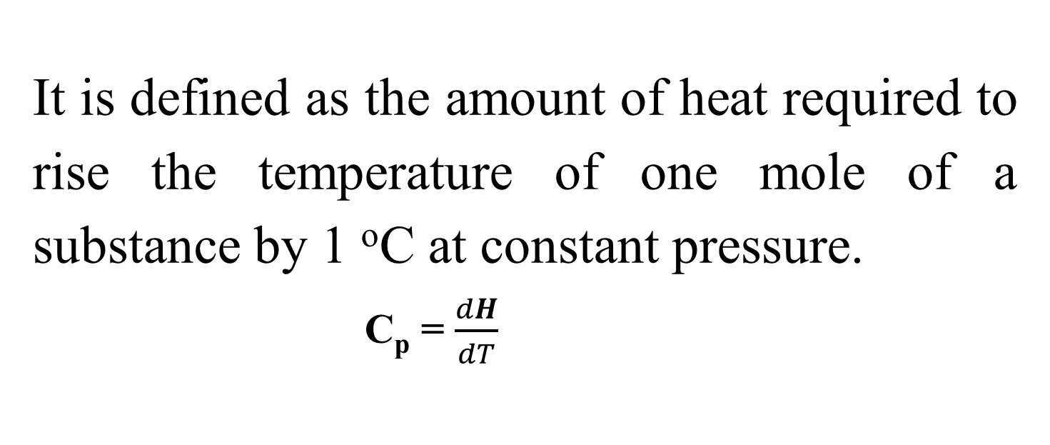
C_{p}: Molar heat capacity at constant pressure
It is defined as the amount of heat required to rise the temperature of one mole of a substance by 1 ºC at constant pressure.
C_{p} = $\frac{dH}{dT}$

Slide 17
C_{p}: Molar heat capacity at constant preure
Heat capacity of a system at constant pressure is defined as the increase in enthalpy of the system per degree rise of temperature at constant pressure. Or
It is the rate of change of enthalpy with temperature at constant pressure.

Slide 18
The relation between C_{p} and C_{v}
The relation between C_{P} and C_{v} for an ideal gas is given by,
C_{P} - C_{V} = R
Or
C_{p} = C_{v} + R
Where R is the universal gas constant.

Slide 19
The relation between C_{p} and C_{v}
The molar heat capacity of a substance at constant pressure is always greater than the molar heat capacity at constant pressure i.e.
C_{P} > C_{V}

Slide 20
The relation between C_{p} and C_{v}
When a substance is heated at constant volume, no work is done by the substance and thus the heat absorbed by the system is used completely to increase the internal energy of the substance.

Slide 21
The relation between C_{p} and C_{v}
When a substance is heated at constant pressure, do some external work in addition to increase in the internal energy of the substance.
Hence C_{p} is always greater then C_{v}.
Cp > Cv

Slide 22
Show that C_{p} - C_{v} = R
The molar heat capacity at constant volume C_{V}, is given by
q_{v} = C_{V} ∆T = ∆E
The molar heat capacity at constant pressure C_{P} is given by,
q_{p} = C_{p} ∆T = ∆H

Slide 23
Show that C_{p} - C_{v} = R
For one mole of an ideal gas,
∆H = ∆E + ∆ (PV) = ∆E + ∆ (RT) = ∆E + R ∆T
Thus,
∆H = ∆E + R ∆T

Slide 24
Show that C_{p} - C_{v} = R
We know that,
q_{p} = C_{p} ∆T = ∆H
Then,
C_{p} ∆T = ∆H
C_{p} ∆T = ∆E + R ∆T
C_{p} ∆T = C_{V} ∆T + R ∆T

Slide 25
Show that C_{p} - C_{v} = R
Then,
C_{p} ∆T = C_{V} ∆T + R ∆T
C_{p} = C_{V} + R
Hence,
C_{p} - C_{V} = R

Slide 26
Thank You……

