Slide 1
Thermodynamics & Carnots engine
K JAYADEV
Lecturer in Physics
P.R.Govt.College(A)
Kakinada

Slide 2
Thermodynamics& Carnots cycle
Thermodynamics is a branch of Physics which deals with the conversion of Heat energy to the Mechanical energy and vice versa.
Reversible process is one which can be reversed in such a way that all changes occurring in the direct process are exactly repeated in the opposite order and inverse sense and no changes are left in any of the bodies taking part in the process or in the surroundings

Slide 3
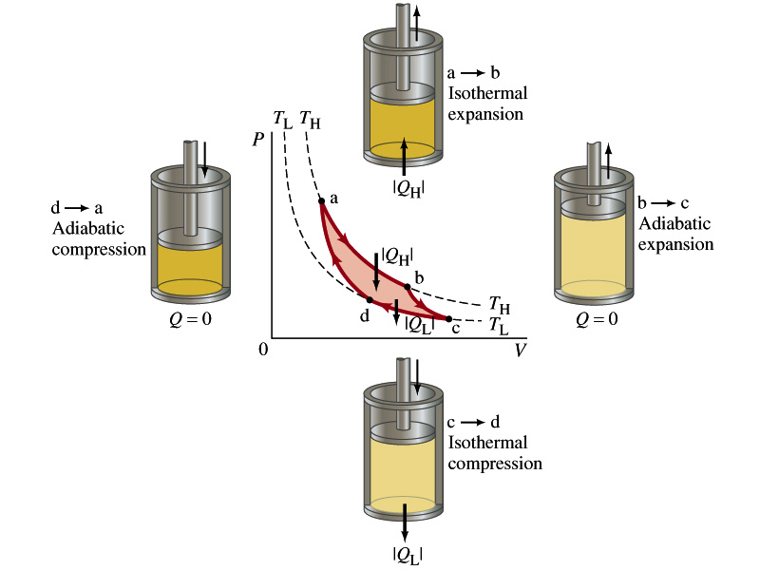
The Carnot Cycle.
The Carnot cycle is an example of a reversible process, which is a process that can be done in reverse.
A reversible process requires that any changes are made infinitely slowly.
Real processes are not reversible due to for example friction , turbulence in the gas, etc.

Slide 4
Irreversible process is one which is not reversible.
Work done by/on a gas

Slide 5
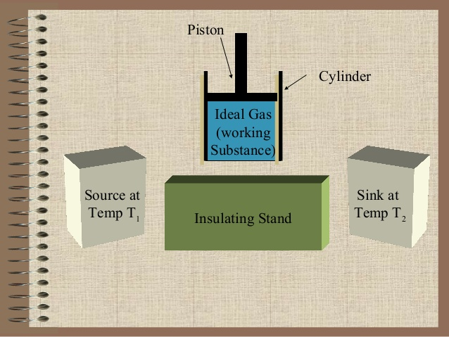
Block diagram of Carnots Engine

Slide 6
Theory
Carnots engine consists the following 4 parts
i) The working substance: It is an Ideal gas enclosed in cylinder piston arrangement with perfectly non conducting walls and perfectly conducting base
ii) The Source: A hot body of high thermal capacity maintained at a high temperature T1 K serves as Source.
iii) The Sink: A cold body maintained at a lower temperature at T2 K serves as sink
iv) Insulating Stand: To make the whole system perfectly non conducting stand is put on the base of the cylinder.

Slide 7
The Carnot Cycle.

Slide 8
The working substance is made to undergo a cyclic operation made up of four parts. i) Isothermal Expansion (ab): Heat absorbed from the Source be Q1, this is equal to the amount of work done W1 by the gas. Q1 = W1 = ∫ PdV = ∫ RT1 (dV/V) = RT1 loge (V2/V1) ----- (1) ii) Adiabatic Expansion (bc) : In this case the work is done at the cost of internal energy. This work W2 is given by W2 = ∫ PdV = ∫ K (dV/V ) W2 = (RT2 – RT1)/(1 – ) W2 = (RT1 – RT2)/(γ -1) ----- (2)
γ
γ

Slide 9
iii) Isothermal Compression(cd): In this case, the developed heat inside the system passes to the sink. Let the heat rejected to the sink Q2 is equal to the work done W3 on the gas. Q2 = W3 = ∫ PdV = ∫ RT2 (dV/V) = RT2 loge (V4/V3) W3 = - RT2 loge (V3/V4) ------(3) iv) Adiabatic Compression (da): In this case the temperature rises from T2 to T1. This work done W4 on the gas is given by W4 = ∫ PdV = ∫ K (dV/V ) W4 = (RT1 – RT2)/(1– γ ) W4 = - (RT1 – RT2)/(γ -1) ------ (4)

Slide 10
Hence the Total workdone by the gas W = W1+W2+W3+W4 W = RT1 log ( ) – RT2 log ( ) ----------- (5) As the points “b” and “c” lie on same adiabatic, hence T₁V₂^{γ-1} = T₂V₃^{γ-1} ⁻⁻⁻⁻⁻⁻⁻⁻⁻⁻⁻⁻⁻⁻⁻⁻⁻⁻⁻ ⁽⁶⁾ Again the points “a” and “d” lie on the same adiabatic, T₁V₁^{γ-1} = T₂V₄^{γ-1} = ( )^{(γ-1) ---------------- (7)} ^{= or =} Substituting this value in eq.(5) , we get W = RT1 log ( ) – RT2 log ( ) = R (T1 – T2 ) log ( )
= (
)^{(γ-1)}

Slide 11
η = Work done by the engine ₌ Heat converted into work Heat taken from Source Heat taken η = W R (T1 – T2 ) log ( ) Q1 = R T1 log ( ) η = T1 – T2 T1 η = 1 -

Slide 12
Have a great day

