Slide 1
Bioinorganic Chemistry
SAIKRISHNA UGGU
Lecturer in Chemistry
P. R. Govt. College (A)
KAKINADA

Slide 2
Contents…
Classification of metal ions
Biological significance of
Na, K, Mg, Ca, Fe, Co, Ni, Cu, Zn and Cl-
Structure and functions of Hemoglobin, myoglobin & chlorophyll

Slide 3
The living bodies contain at least 30 elements which are divided into
Essential elements
Non– Essential elements

Slide 4
Essential elements are defined as those elements which are required to maintain the normal living state of a tissue or whole of the body. These are divided into
Macro elements and
Micro elements.

Slide 5
MACRO ELEMENTS
These are the elements which are required to be present in the diet to the extent of more than one milligram.
Ex : C, H, O, N, Na, K,
Ca, Mg, Fe, p, S and Cl

Slide 6
MICRO ELEMENTS
Micro elements are those which are required in
very small amount say to the extent of micro
grams or nano grams in the body.
Ex : Cu,Zn,Co, Cd, Mn, 12, and F2.

Slide 7
NON - ESSENTIAL ELEMENTS
The functions of the elements are not clearly known and hence they are called non -essential elements. Some of them are toxic in nature.
Ex: Br2, B, Si ,As, Ni ,Al , Pb, V and Ti present in the body

Slide 8
BIOLOGICAL SIGNIFICANCE OF ZINC
Zinc ion : Zinc is widely distributed in vegetables and animal food.
Human body requires 0.3 mg per Kg of the body per day
Zinc is integral part of several biochemically important enzymes such as uricase, arbonic anhydrase , liver alcohol dehydrogenase, carboxy peptidase , kidney phophatase etc.
lnsulin contains zinc and during diabetes, the total zinc will be reduced to half in pancreas
Low quantity of zinc results in poor body and poor growth.

Slide 9
BIOLOGICAL SIGNIFICANCE OF COBALT
Cobalt is the essential content of vitamin B12.
The chemical name of this vitamin is cyanocobalamine.
Cobalt is required to maintain normal function of bone
marrow in producing erythrocytes
Deficiency of cobalt leads to limited supply of vitamin
B12 which leads to nutritional type of anaemia.
Excess of cobalt produces more of erythrocytes and this
causes poly cythaemia.

Slide 10
BIOLOGICAL SIGNIFICANCE OF COPPER
Copper ions present in water form complexes readily at a PH range of 6.5 to I0" The complexes of the ion with humic acid reduces its toxicity. The soluble copper ions present in water can also be removed by reagents like sodium or ammonium acetate hydroxyl amine hydrogen peroxide, hydrogen fluoride etc. Copper is an integral part of certain enzymes it is essential in their activity, such as cytochromes, cytochrome oxidase, catalase, uricase,etc.
These enzymes contain as much as 550 µg copper per gram of the enzymes protein. Copper is also postulated to help in the bone formation and maintenance of the myelin sheath in the nerve fibres.

Slide 11
BIOLOGICAL SIGNIFICANCE OF CHLORIDE ION
The harmless amount of chloride in water is around 250 - 300 ppm The most important source of chlorine together with sodium is in the diet as common salt.
Healthy individual is rarely subjected to chlorine deficiency. Diarrhoea, vomiting , extreme perspiration cause deficiency of chlorine and sodium .
Congestive heart disease, hypertensive high blood pressure, kidney disease , sodium ,chloride restricted diet is suggested.

Slide 12
BIOLOGICAL SIGNIFICANCE OF Na,K,Cl2
Sodium, potassium and chlorine have intimate relation among them. Thus the metabolic and nutritional importance of these elements.
Common salt (sodium chloride) is the most important source of the two elements sodium and chlorine.
Plants contain less amounts of sodium while potassium is found in majority of the foods of both animal and plants sources.
Sources of potassium: Coffee, tea, potatoes, dried beans, green and leafy vegetables, milk, bananas, juice of oranges, pine apples, beef, fish,

Slide 13
Function of sodium and potassium ions
Maintenance of normal hydration and osmotic pressure:
These ions maintain the normal osmotic pressure of different fluids in the body. This will prevent the excessive loss of fluids and thus dehydration.
Maintenance of normal acid - base equilibrium:
Salt of weak acids plus sodium or potassium ion , form the main buffer system which plays an important role in maintaining the PH value of various fluids of the body ' Sodium salts form buffer system of extra cellular fluids while potassium salts form buffer systems of intra cellular fluids.
Transport of carbon dioxide: Sodium and potassium ions along with chloride ions play an important role in the transportation of gaseous CO2.
Neuro muscular irritabilitY:
Sodium and potassium ions are important in maintaining neuromuscular irritability and excitability.

Slide 14
BIOLOGICAL SIGNIFICANCE OF IRON
lron is essential in small amounts for both plants and animal life" However like Cu and Se it is toxic in large quantities. Biologically iron is the most important transition element. lt is involved in several different processes.
As an oxygen carrier in the blood of mammals, birds and fish (haemoglobin)“
For oxygen storage in muscle tissue.
As an electron transfer in plants and bacteria (cytochromes) and for electron transfer in bacteria (ferredoxins).
For storage and scavenging of Fe in animals.
The human body contains 4 gm of iron. AboutT}% of this is found as haemoblobin, the red pigment in the erythrocytes (red blood cells).

Slide 15
BIOLOGICAL SIGNIFICANCE OF Mg
Magnesium is one of the most important element that affect numerous processes inside our body.
Activity of enzvmes:
Mg plays a crucial role in the biochemical reactions occurring in our body.
Magnesium acts as an enzyme co-factor plays an important role in the breaking of glucose and fat molecules, in the production of enzymes, proteins and regulation of cholesterol.
Protector of human DNA:
DNA synthesis is not possible without the sufficient supply of this Mg ion.

Slide 16
BIOLOGICAL SIGNIFICANCE OF CALCIUM
Calcium is mainly found in the bones and teeth of the living beings.
Calcium helps in blood clotting. Deficiency of calcium increases the blood clotting time
Calcium supports muscle contraction.
The deficiency of this metal leads to disorder of nerves.
Calcium plays a significant role in the metabolism of nitrogen in plants. Absence of this mineral in the plants affects the size and number of chloroplasts.

Slide 17
HEMOGLOBIN
Hemoglobin is the red pigment of blood and is a chromo protein which contains four 'heme' units attached to a polypeptide chain. The heme units are ferroporphyrin units which carry oxygen in the blood.
The two component portions of hemoglobin are Globin and ferroproto porphyrin (heme)
The iron compounds of porphyrins can exist in two forms.
a. Divalent lron - ferroproto porphyrin. lt is known as heme. This group has no net charge.
b. Trivalent lron - ferriproto porphyrin. lt is known as hemin. This group has net positive charge.

Slide 18
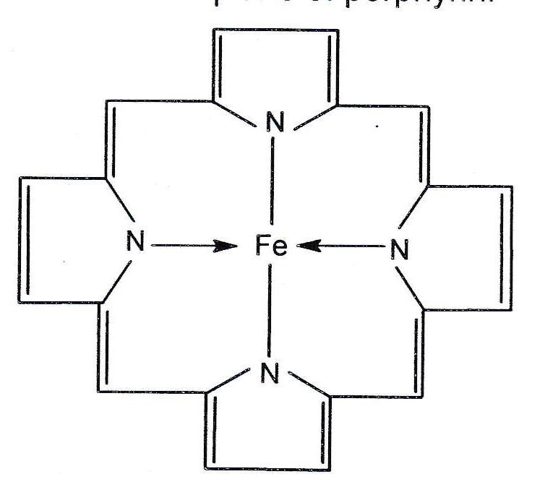
Heme and other similar chelates of divalent metal ions exist in square planar forms.
Hemin is usually obtained as the chloride. The resulting penta coordinated complex is essentially square pyramidal. The chloride anion is bound only co-ordinately but not electrostatically to the iron ion perpendicular to the plane of porphyrin.

Slide 19
MYOGLOBIN
Haem is also important biologically in Myoglobin which is used to store dioxygen in muscles. Myoglobin is similar to one of the units in haemoglobin.
lt contains only one Fe atom, has a molecule weight of about 17000, and binds 02 more strongly than haemoglobin.

Slide 20
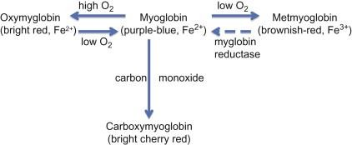

Slide 21
Two yellow pigments (carotenes and xanthophylls) and Two green pigments.
CHLOROPHYLL
Chlorophyll is the green colouring matter of plants, especially leaves. lt is found in definite protoplasmic bodies, called chloroplasts. Chloroplasts mainly contain four different pigments.

Slide 22
Chlorophyll
The natural chlorophyll is a mixture of two different chlorophylls: 'Chlorophyll a' and 'chlorophyll b', which are found in the ratio 3:1 in the higher plants.
In algae the ratio is much higher than 3:1; moreover there are some algae which do not contain chlorophyll b at all.
Biologically, chlorophyll is very important natural Pigments as it is responsible directly or indirectly for the synthesis of all kinds of food (carbohydrates, fats, proteins, vitamins, etc).

Slide 23
Chlorophyll
Chlorophyll absorbs light energy and in this activated form it reduces carbon dioxide forming a carbohydrate type molecule with the evolution of oxygen (photo synthesis)
Moreover, chlorophyll also maintains carbon dioxide - oxygen equilibrium in atmosphere as oxygen is given out at the expense of carbon dioxide.

Slide 24
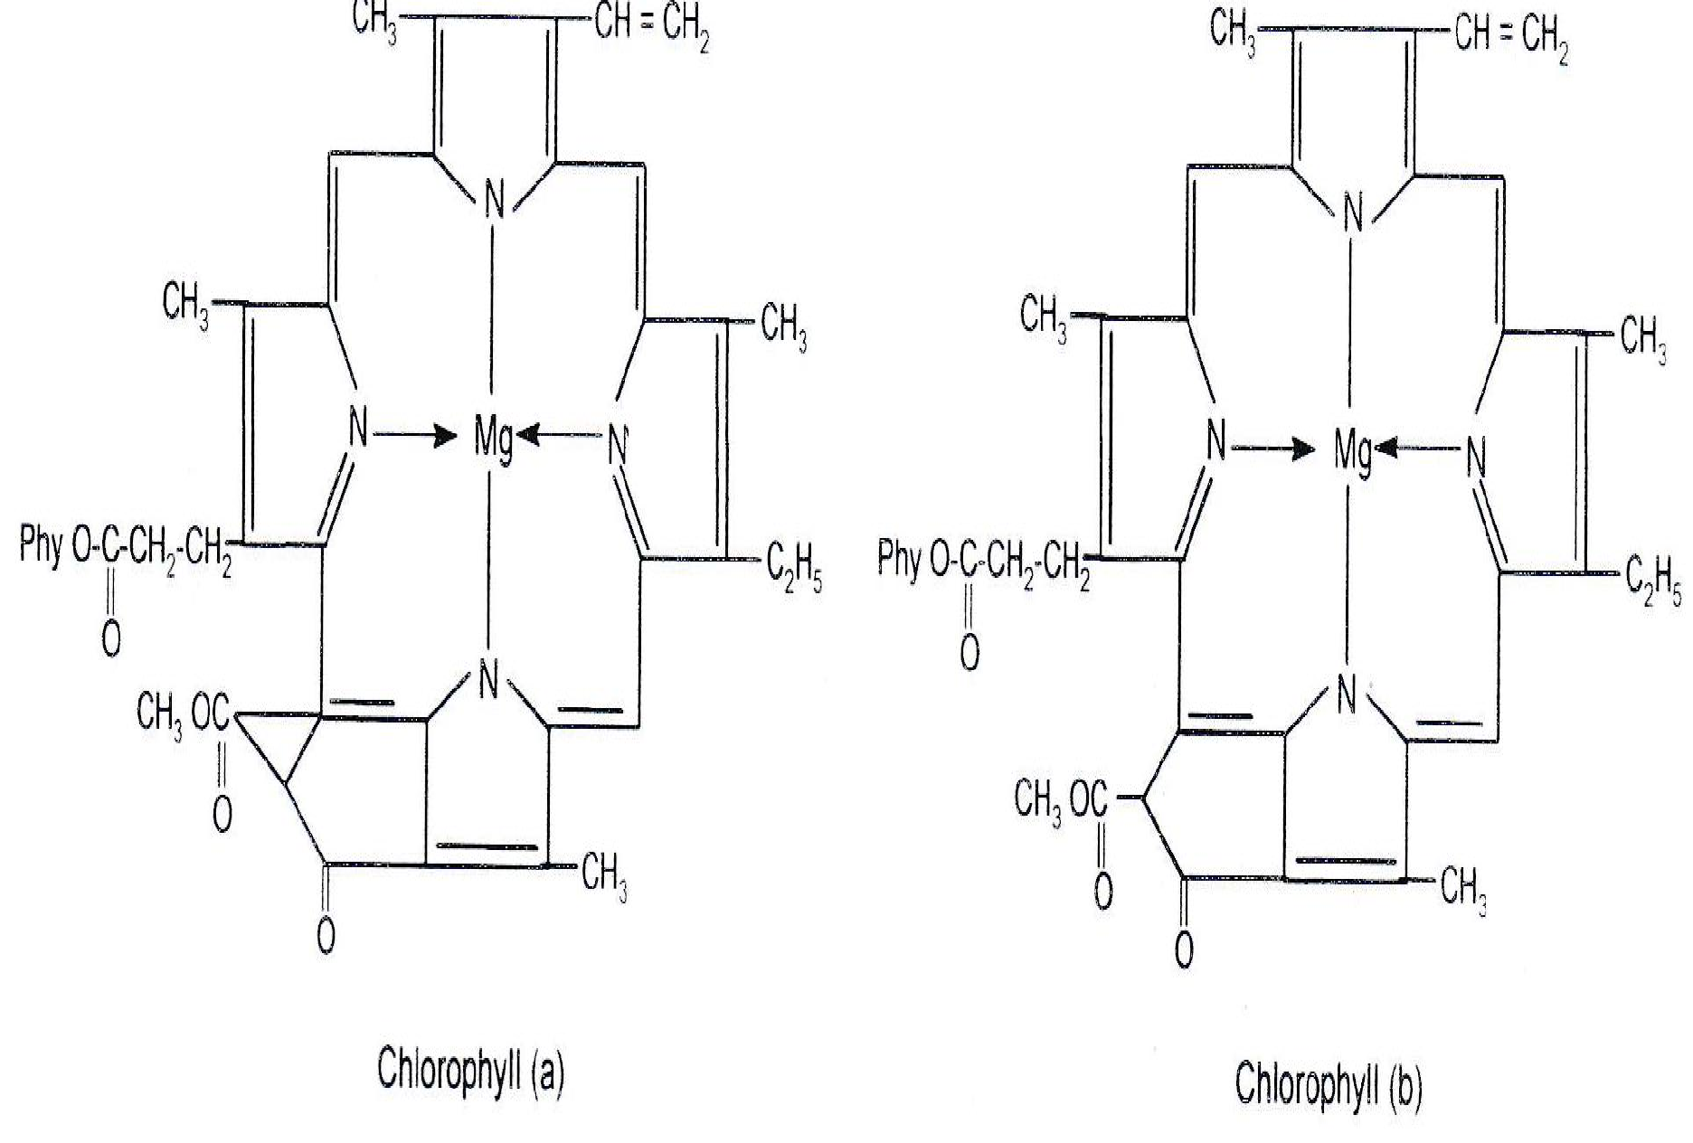

Slide 25
Essay Questions:
Explain the structure and function of Haemoglobin and chlorophyll.
Short Answer Questions:
What are essential elements and importance of Na and K in biological systems.
Explain about metallo phorphyrins

Slide 26
Thank You……

